Slide 1
Clergy Peer Learning Group
February 29, 2024
“Let us consider how we might spur one another on toward love and good deeds. Let us not give up meeting together, as some are in the habit of doing, but let us encourage one another.” Hebrews 10:24-25

Slide 2
Group Charter/Covenant
We have come together to strive for spiritual growth in our ministry, our lives, and our faith. Endeavoring to free ourselves from the too frequent isolation that our vocation precipitates, we commit ourselves now to each other and to sharing the full work of health: spiritual, emotional, and physical. We have assembled to support each other in a process of education and growth that has deepening faith in Christ as its sole goal. To this end, we are committed to asking hard questions of ourselves but in a safe place – one set apart. In this place of confidence, we commit ourselves to trust and honesty. What we discuss, we share with full expectation of confessional privacy as among brothers. What we entrust to each other, we do so confident that charity, compassion, and respect for the differences between us inform our interactions. What we proffer to this body, we divulge not to receive advice but understanding, not solutions but the empathy of problems shared. It is our intention to meet four times each year (and to possibly plan one additional social gathering as well). For this we ask the blessings of Almighty God; to commit ourselves in faith and prayer.

Slide 3
Check-in time (3-4 minutes each person)
How are you?
physical health
spiritual health
marriage/family
ministry/parish
more…..

Slide 4
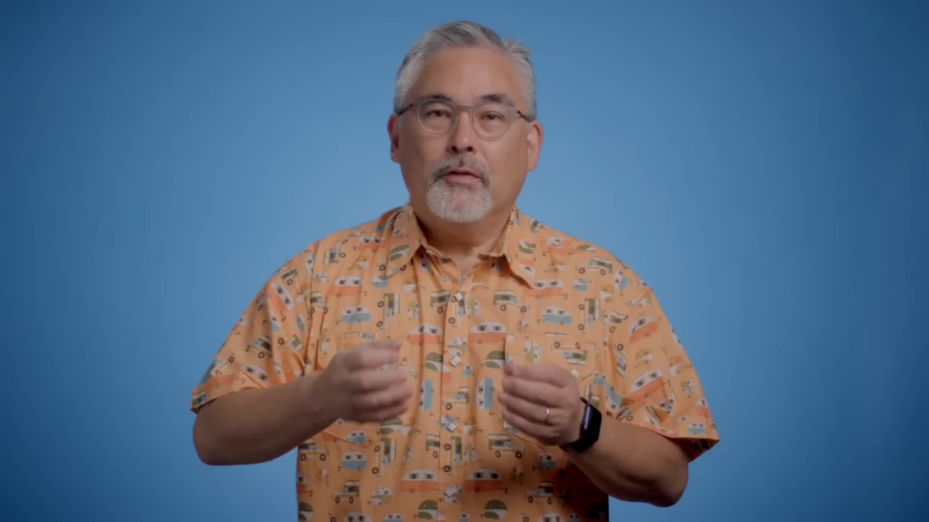
How Rest Can Make You Better At Your Job

Slide 5
Reflection/Journal Questions on How Rest Can Make You Better At Your Job
Rethink what rest is
Do you move around enough in a given day?
2. Integrate it into your daily work
Can you turn off your phone to rest at different points in your day?
3. Tap into deep play
What are your hobbies to offset ministry demands?
4. Make rest social
Are you content with you social network?

Slide 6
Movement Exercise
On a wall-to-wall continuum do you:
Plan every detail
or
thrive on spontaneity?

Slide 7
Journal/Reflection Question
Complete the sentence:
I feel valued when ________________

Slide 8
For by the grace given to me I say to everyone among you not to think of yourself more highly than you ought to think but to think with sober judgment, each according to the measure of faith that God has assigned. For as in one body we have many members and not all the members have the same function, so we, who are many, are one body in Christ, and individually we are members one of another. We have gifts that differ according to the grace given to us: prophecy, in proportion to faith; ministry, in ministering; the teacher, in teaching; the encourager, in encouragement; the giver, in sincerity; the leader, in diligence; the compassionate, in cheerfulness. Romans 12:3-8
As you think with “sober judgement” about yourself, which gift(s) do you think God has given you ?
What overall theme/message is St Paul conveying to the community?

Slide 9
Reflection/Journal Question
In a word or phrase…
How would you describe this season of your life?

Slide 10
Matin Hymns from Clean Monday
The Fast is here, the mother of chastity, the accuser of sins, the advocate of repentance, the life of angels and the salvation of men, faithful, let us cry: O God, have mercy on us.
Beyond all hope, I am wondrously set free, Mother of God, from all that troubles me, for I have obtained in my distress your invincible intercession! You are always swift to help those who beseech you in faith, dispelling the darkness of their many sins. Therefore, with thanksgiving, I cry to you: Accept, Lady, this small offering of grateful praise, and be my help in all things!

