Slide 1
Clergy Peer Learning Group
February 13, 2020
“Let us consider how we might spur one another on toward love and good deeds. Let us not give up meeting together, as some are in the habit of doing, but let us encourage one another.” Hebrews 10:24-25

Slide 2
Group Charter/Covenant
We have come together to strive for spiritual growth in our ministry, our lives, and our faith. Endeavoring to free ourselves from the too frequent isolation that our vocation precipitates, we commit ourselves now to each other and to sharing the full work of health: spiritual, emotional, and physical. We have assembled to support each other in a process of education and growth that has deepening faith in Christ as its sole goal. To this end, we are committed to asking hard questions of ourselves but in a safe place – one set apart. In this place of confidence, we commit ourselves to trust and honesty. What we discuss, we share with full expectation of confessional privacy as among brothers. What we entrust to each other, we do so confident that charity, compassion, and respect for the differences between us inform our interactions. What we proffer to this body, we divulge not to receive advice but understanding, not solutions but the empathy of problems shared. It is our intention to meet four times each year (and to possibly plan one additional social gathering as well). For this we ask the blessings of Almighty God; to commit ourselves in faith and prayer.

Slide 3
Check-in time (3-4 minutes each person)
How are you?
physical health
spiritual health
marriage/family
ministry/parish
more…..

Slide 4
Shawshenk Redemption – “Get Busy Living or Get Busy Dying

Slide 5
Journal/Discuss:
What goals or hopes do you wish to accomplish in the remaining years of your ministry?
What does retirement look like for you and your wife?
What do you hope people/parishioners will say about you at your retirement or funeral?

Slide 6
What is Inter-personal Conflict?
Confrontation
Clash of interests
Argumentation
Single issue or chronic dissatisfaction

Slide 7
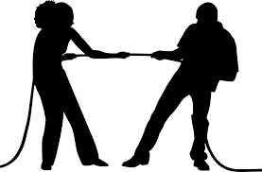
Interpersonal Conflict begins with…
Matters of value
Concern
Action
Philosophy
It can end with…
Agitation
Anger
Hostile action
Termination of bonds of friendship and/or marriage

Slide 8
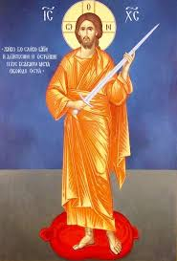
Jesus and Conflict
“Do not think that I have come to bring peace on earth; I have not come to bring peace, but a sword. For I have come to set a man against his father, and a daughter against her mother, and a daughter-in-law against her mother-in-law; and a man’s foes will be those of his own household. He who loves father or mother more than me is not worthy of me; and he who loves son or daughter more than me is not worthy of me; and he who does not take his cross and follow me is not worthy of me. He who finds his life will lose it, and he who loses his life for my sake will find it.”
Matthew 10:34-39

Slide 9
Jesus and Conflict – Scriptural Examples
Conflict with religious leaders over interpretation of Mosaic Law
Mt 5:21-28 Mk 7:1-23
Conflict with crowds who Jesus refuses to gratify
Jn 6:15, 26
Conflict with Jesus’ family
Lk 2:41-52 Mk 3:31-35
Conflict with Jesus’ disciples
Mk 4:13; 8:14-21; 10:35-45

Slide 10
Jesus and Conflict – Provoking Acts
Dined with tax collectors and sinners
Mk 2:15-17 Lk 15:1-2
Called women to be disciples
Lk 10:38-42 Mt 28:9-10 Jn 20:11-18
Held up Gentiles and Samaritans as models of faith
Mt 8:15 Lk 10:29-37
Renounced traditional family relationships
Mt 10:34-39

Slide 11
Reflection Questions:
How do you react/respond to conflict – whether it be in your family or your parish?
(Mentally – Physically - Spiritually)
2) How did your family of origin deal with conflict? How was conflict resolved in your family of origin?
3) What methods/resources have you found helpful in bringing about healing in conflictual situations?

Slide 12
Jesus’ Response to Conflict
Jesus was a superb listener who took in not only words but the thoughts expressed beneath the words.
Jesus was not afraid of anger, but his anger was always controlled and in proportion to the issue concerned.
Jesus did not back away from situations of conflict. He welcomed conflict as a positive opportunity.
Even in conflictual situations, Jesus’ priority was forgiveness and pardon.
Jesus found his disciples infuriating on occasions, with their slowness to learn and “little faith.” He was, however, always patient with them.
On a number of occasions Jesus withdrew from the crowds when volatile conflict developed.
Jesus was “despised and rejected” (Isaiah 53:3) yet the constant spiritual, emotional, and physical battering he received never once deflected him from his overall goal of love and service to others.

Slide 13
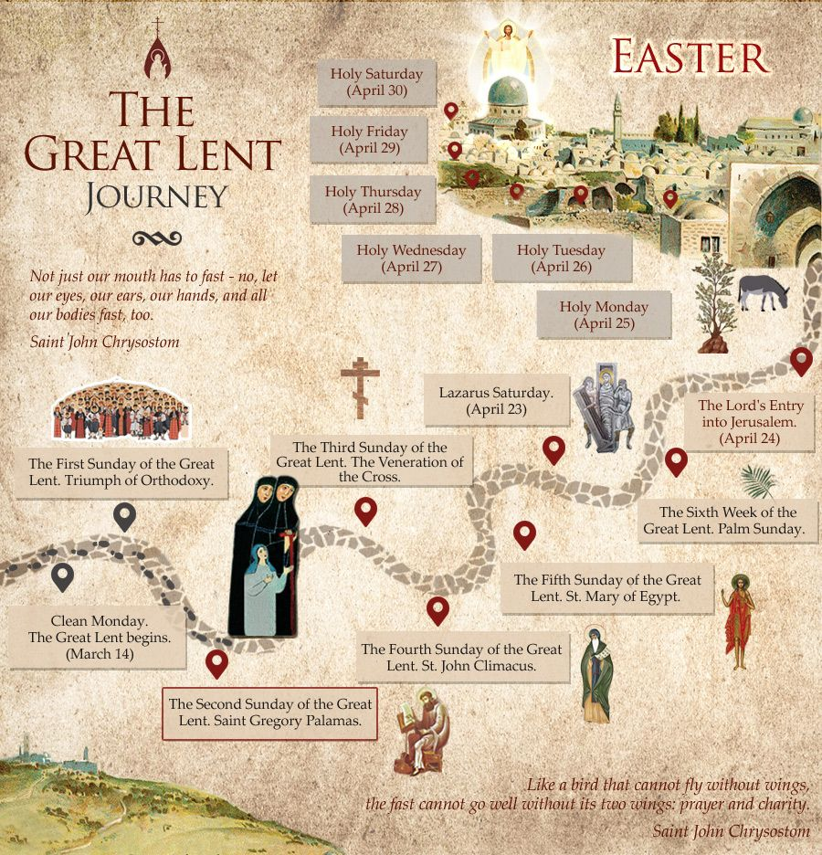
What is your plan for Great Lent this year for your personal growth?

Slide 14
We read this prayer numerous times throughout Great Lent. What word stands out to you TODAY as we prepare for this year’s journey?

Slide 15
