Slide 1
Clergy Peer Learning Group
August 22, 2019
“Let us consider how we might spur one another on toward love and good deeds. Let us not give up meeting together, as some are in the habit of doing, but let us encourage one another.” Hebrews 10:24-25

Slide 2
Group Charter/Covenant
We have come together to strive for spiritual growth in our ministry, our lives, and our faith. Endeavoring to free ourselves from the too frequent isolation that our vocation precipitates, we commit ourselves now to each other and to sharing the full work of health: spiritual, emotional, and physical. We have assembled to support each other in a process of education and growth that has deepening faith in Christ as its sole goal. To this end, we are committed to asking hard questions of ourselves but in a safe place – one set apart. In this place of confidence, we commit ourselves to trust and honesty. What we discuss, we share with full expectation of confessional privacy as among brothers. What we entrust to each other, we do so confident that charity, compassion, and respect for the differences between us inform our interactions. What we proffer to this body, we divulge not to receive advice but understanding, not solutions but the empathy of problems shared. It is our intention to meet four times each year (and to possibly plan one additional social gathering as well). For this we ask the blessings of Almighty God; to commit ourselves in faith and prayer.

Slide 3
Check-in time (3-4 minutes each person)
How are you?
physical health
spiritual health
marriage/family
ministry/parish
more…..

Slide 4

5 Best Personal Finance Tips

Slide 5
5 Best Personal Finance Tips
Start Investing Early
Avoid Conspicuous Consumption
Don’t Pay Interest
Have an Emergency Fund
Budget for Everything
How does this list reflect on your family’s financial condition?
How can this list serve as a pastoral tool for your parishioners?

Slide 6
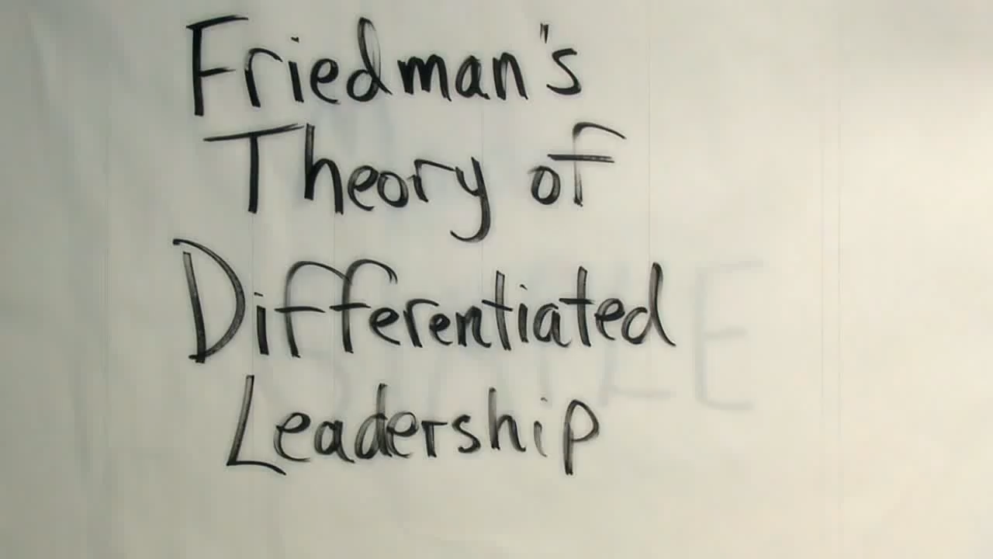
Differentiated Leadership

Slide 7
Differentiated Leadership
Quotes from “Saying No to Say Yes: Everyday Boundaries and Pastoral Excellence”
Too often boundaries are viewed as negative restrictions, rather than limits that promote and contribute to health.
On the simplest level, boundaries define the separation between self and others. A person with a healthy sense of self knows what he or she wants and needs and is able to say “no” to what is not helpful and request more of what he or she needs.
While boundaries can be too permeable, they can also be too rigid.

Slide 8
Differentiated Leadership
Quotes from “Saying No to Say Yes: Everyday Boundaries and Pastoral Excellence”
Differentiation of self is the ability to contain our reactivity in the midst of anxiety, not become emotionally reactive, and stay connected to others in the midst of anxious times.
Differentiation is the ability to be in emotional contact with others yet still autonomous in one’s emotional functioning. It is the ability to maintain emotional objectivity while in the midst of an emotional system in turmoil.

Slide 9
Differentiated Leadership
Quotes from “Saying No to Say Yes: Everyday Boundaries and Pastoral Excellence”
Clergy must learn to non-reactively stay in relation with a variety of people and groups in their congregations while staying true to themselves while doing it. Trying to keep everyone happy is not differentiation nor is avoiding or cutting off from unpleasant people. Differentiation is the ability to lead, set clear boundaries, say “no” when necessary, while at the same time building intimate relationships – even with those with whom we disagree.

Slide 10
Differentiated Leadership
Reflection/Discussion Questions:
What issues are you most anxious about?
Where/When do you notice yourself becoming most emotional and reactive?
What helps you contain reactive behavior?
What healthy self-soothing practices might help you?

Slide 11
Hymns from Beheading of John the Baptist (August 29)
Kathisma
Come together, believers, and let us all extol John the Baptist who stands in between the Law and Grace; for he publicly proclaimed repentance to us; and courageously denouncing King Herod openly, he was unjustly beheaded. And as he lives now with the angels, he intercedes with Christ to save our souls.
Ainoi
Praise Him with resounding cymbals; praise Him with triumphant cymbals; let everything that breathes praise the Lord.
What an appalling atrocity! The very Angel on earth and the seal of the Prophets all has been shown to be the prize for the dance of a prostitute. The tongue that utters the words of God is sent to those in Hades, foretelling them of Christ. Oh, the ineffable providence that You, O Master, have for all! Therefore save our souls, O Christ alone compassionate.

